Slide 1
Concerns Regarding the Windsor-Essex Hospitals Proposal
LHIN Board Meeting May 24, 2016
Philippa von Ziegenweidt
Citizens for an Accountable Mega-hospital Planning Process
www.windsormegahospital.ca

Slide 2
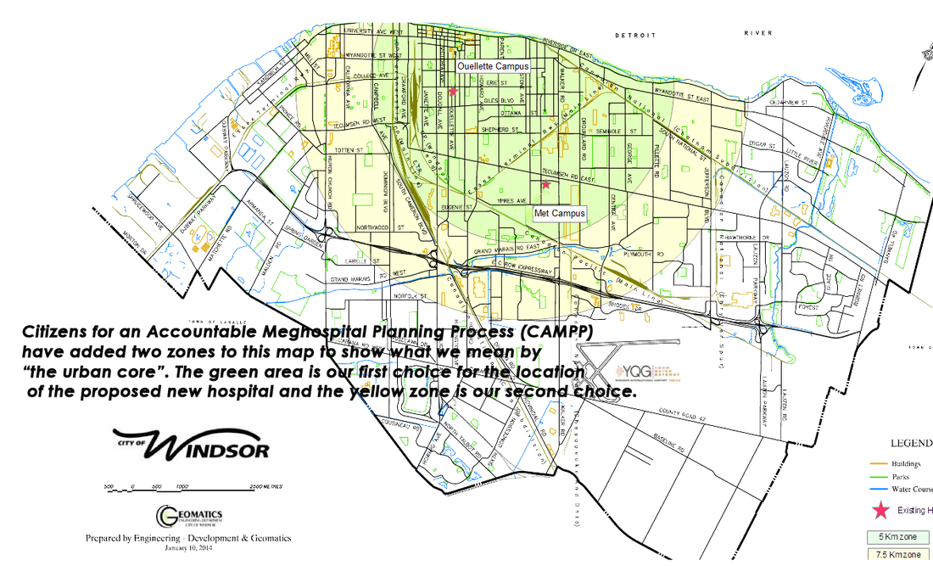
About campP
www.windsormegahospital.ca

Slide 3
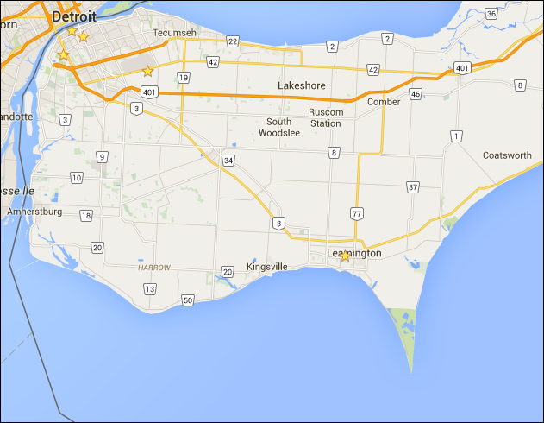
System wide proposal

Slide 4
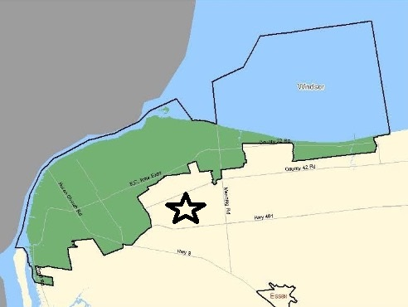
70% of total W-E population lives within
EC Row corridor

Slide 5
CAMPP’s Concerns: “ACUTE”
A
CCESS to the right healthcare services
OST of infrastructure for greenfield construction
RBAN PLANNING
RANSPARENCY lacking in site selection process
NVIRONMENT – farmland protection and amount of driving
C
U
T
E

Slide 6
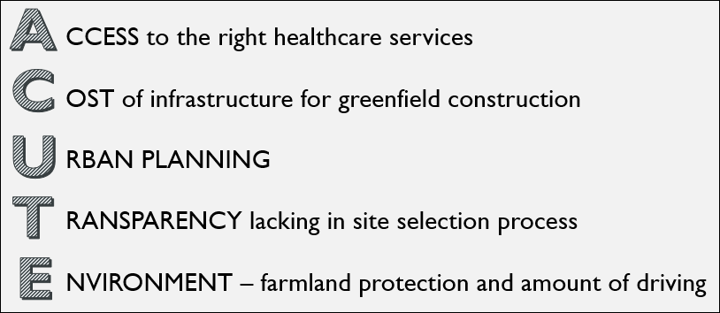
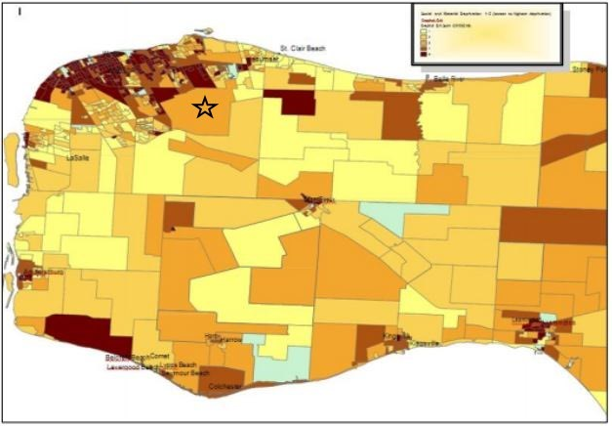
ACCESS
From the ESCLHIN’s IHSP 4 “People First”

Slide 7
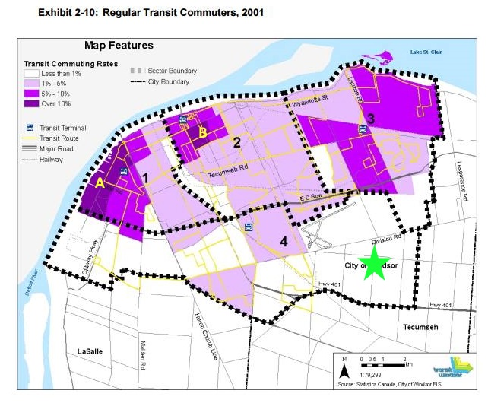
ACCESS
From the City of Windsor’s Transportation Master Plan
Residents of Wards 2 and 3 are significantly more dependent on Transit.

Slide 8
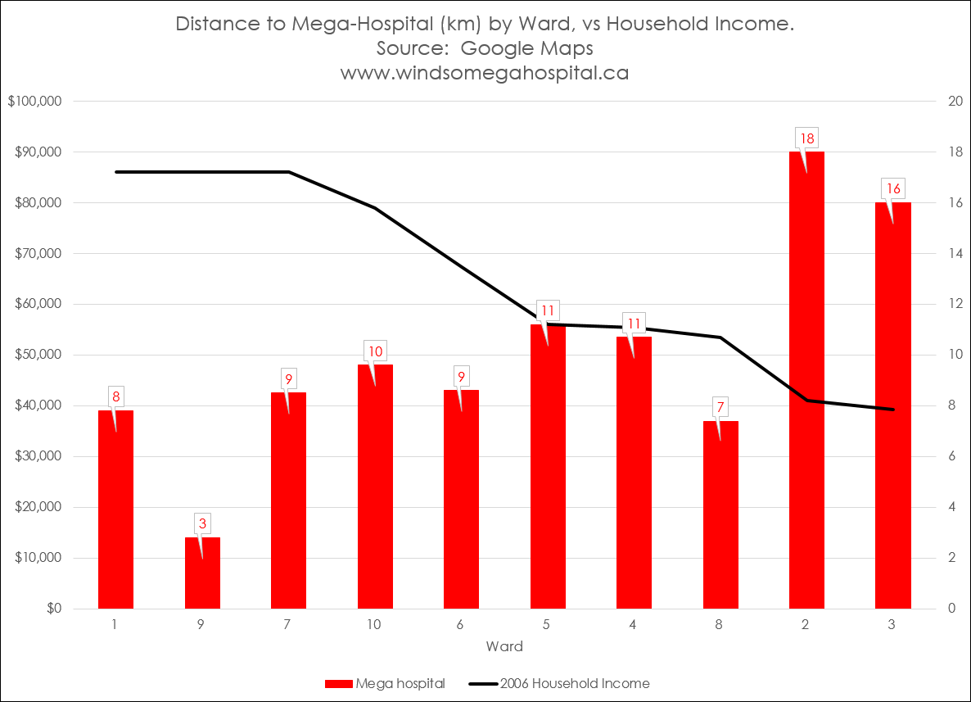
ACCESS
Windsor’s lowest income wards face greatest distance
Further from the core than any other Canadian city!
Income
Provincial & National average
= 3.6km

Slide 9
ACCESS
Urgent Care Centre
If 40% of ER patients can be treated at UCC, what about the other 60%? What analysis is there to know patients will go to the right facility for their needs?
Of the 85% not admitted, what % are referred to specialists at the hospital?
Why no satellites for municipalities with population growth?
What are Ontario’s access benchmarks for cities?

Slide 10
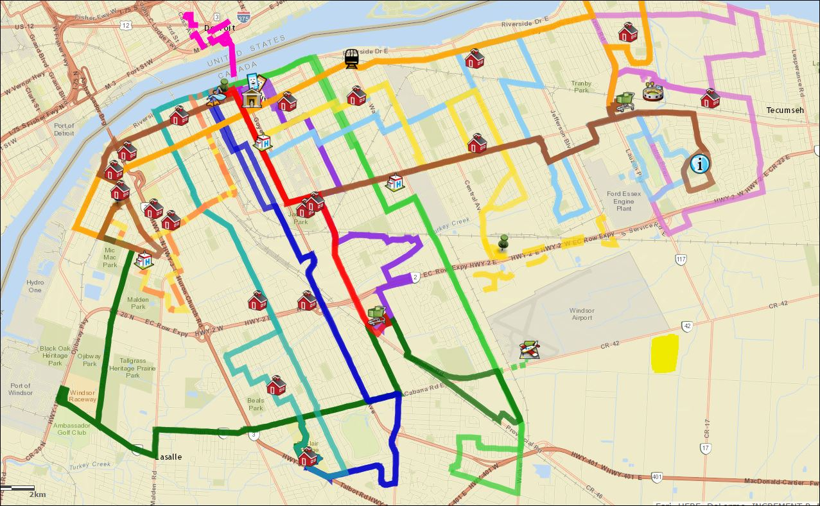
Cost
External Project Costs
Road construction
Hydro
EMS
Public Transit
Financial Cost to Residents

Slide 11
Mandate of shared responsibilities across Government
Urban planning
Provincial Policy Statement related to Land Use Planning & Development – Ministry of Municipal Affairs & Housing:
“Planning authorities shall identify and promote opportunities for intensification and redevelopment where this can be accommodated taking into account existing building stock or areas, including brownfield sites, and the availability of suitable existing or planned infrastructure and public service facilities required to accommodate projected needs.”

Slide 12
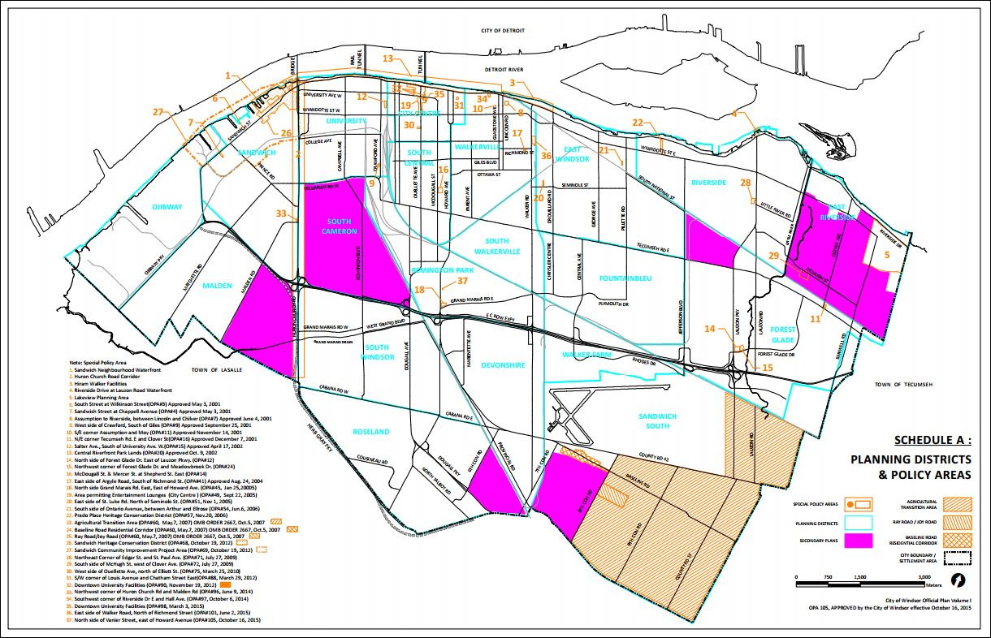
Urban planning
Urban planning

Slide 13
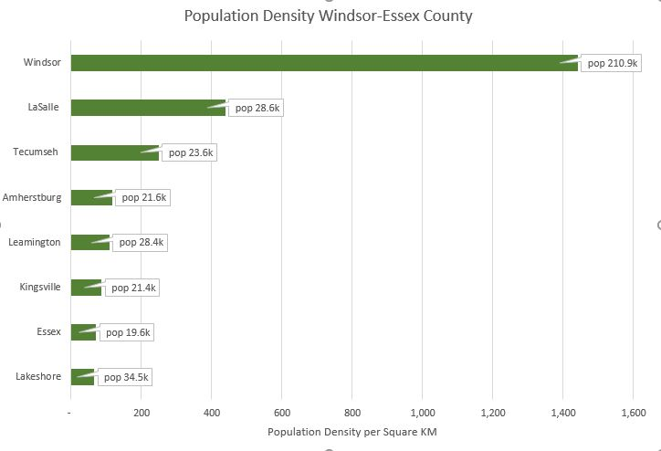
Urban planning
Urban planning
Population Density
7 times greater in the City
Windsor: 1,441
Essex County: 210

Slide 14
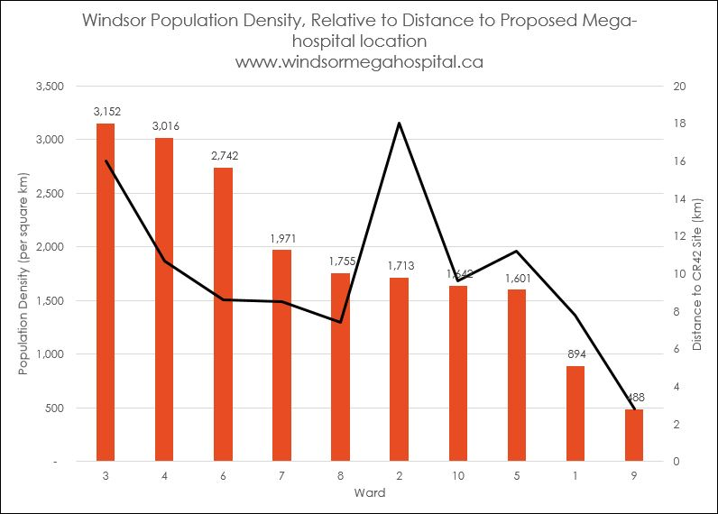
Urban planning
Urban planning
Population Density
15 TIMES GREATER per square kilometer than
Essex County

Slide 15
transparency
“We want to be the most open and transparent government in the country. We want to be a government that works for the people of this province — and with them.
It is of the utmost importance that we lead responsibly, act with integrity, manage spending wisely and are accountable for every action we take.”

Slide 16
ESCLHIN’s Own Model for Stakeholder Engagement
transparency

Slide 17
environment
Mandate of shared responsibilities across Government
Sustainability starts with responsible land use
Ontario’s productive farmland is our most important agricultural resource and it’s non-renewable!
Healthy cities embrace active transportation
Active transportation supports healthy communities
“… build a culture of health and community wellness, including supports and programs, to help people stay healthy.
This will include encouraging Ontarians to play an active role in health care by participating in healthy living & wellness…”

Slide 18
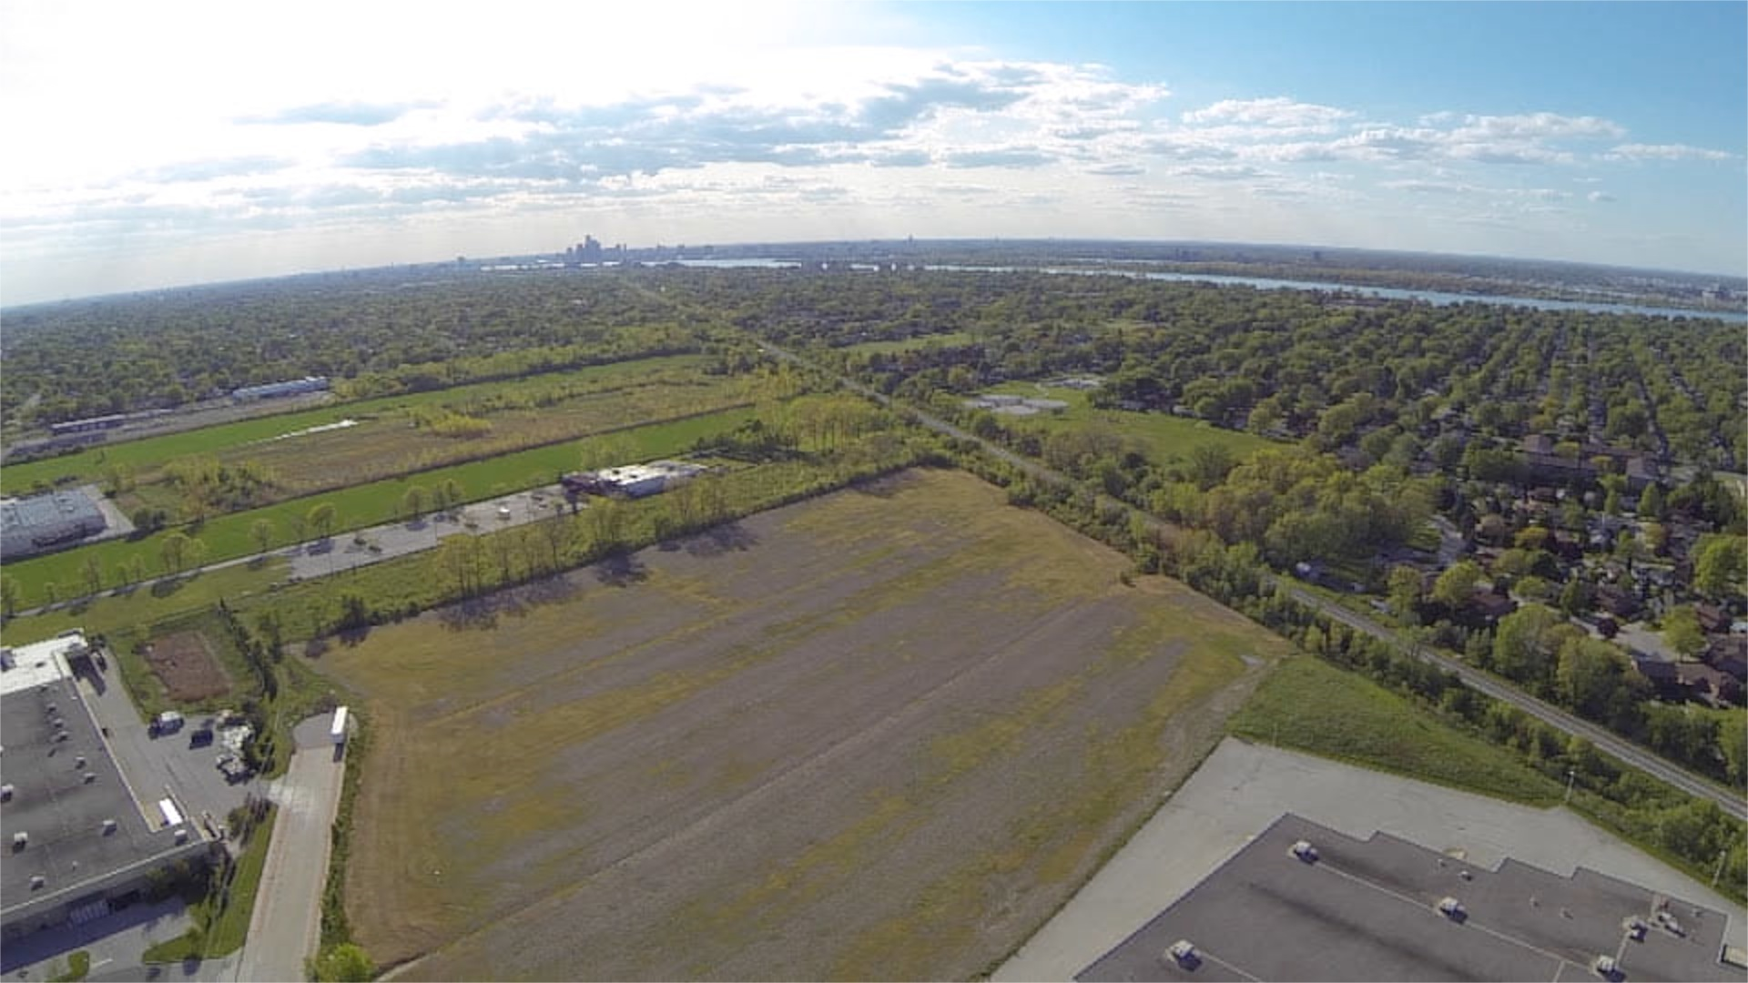
conclusions
www.windsormegahospital.ca

